Slide 1
Workforce Development Spotlight: December 2021 A Summary of Upcoming Career Compass and WFD Opportunities
New Content Coming Your Way!
Live Webinars Coming This Month
Building an Accountability Framework (Accountability; Intermediate Level) – 02 Dec
https://www.navfac.navy.mil/jobs/workforce-development/ccrc/emp_resources/comp_dev_content/accountability.html
SYSCOM Training Opportunities
Please see the following page. The Career Compass Event Calendar has been updated to include all upcoming learning opportunities and trainings across SYSCOM.
https://www.navfac.navy.mil/jobs/workforce-development/ccrc/event-calendar.html
On-Demand Webinars and Resources Coming This Month
Problem Solving – upper Intermediate & Advanced/Expert Levels
Independent Study: Solving Tomorrow’s Problems Today (6-week course available beginning 01 Dec)
https://www.navfac.navy.mil/jobs/workforce-development/ccrc/emp_resources/comp_dev_content/problem-solving.html
For additional details, please talk to your local Civilian Training Advocate (BD17).
*Note: If you are unable to copy and paste the links above, QR codes are available on the following page.

Slide 2
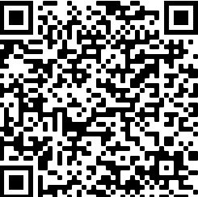
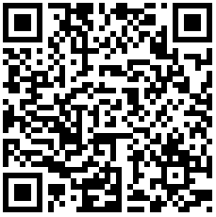
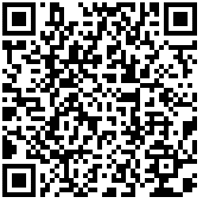
The following QR codes can be used to access the pages referenced in the previous slide.
December SYSCOM Training Summary
Start Date | Event
Wed, 01 Dec | Independent Study: Solving Tomorrow’s Problems Today
Thu, 02 Dec | Live Webinar: Building an Accountability Framework
Mon, 06 Dec | Supervisor Academy’s Current Supervisor Training: Cadre I (East Coast)
Accountability Competency Page
Career Compass Event Calendar
January Courses Open for Registration
Start Date | Event | Registration Deadline
Mon, 10 Jan | Supervisor Academy’s New Supervisor Workshop: Cadre I (West Coast) | Fri, 07 Jan
Problem Solving Competency Page

